Slide 1

PhotonMining© Creating Opportunities SENIOR DESIGN PROJECT – CLASS OF 2021 Electrical & Computer Engineering

Slide 2
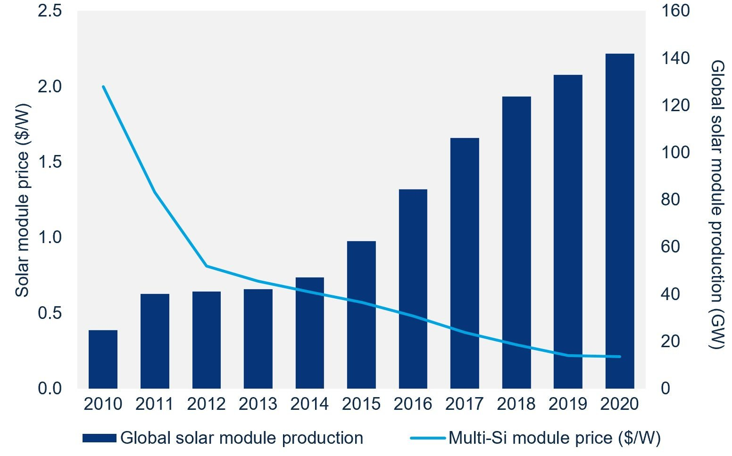

Slide 3

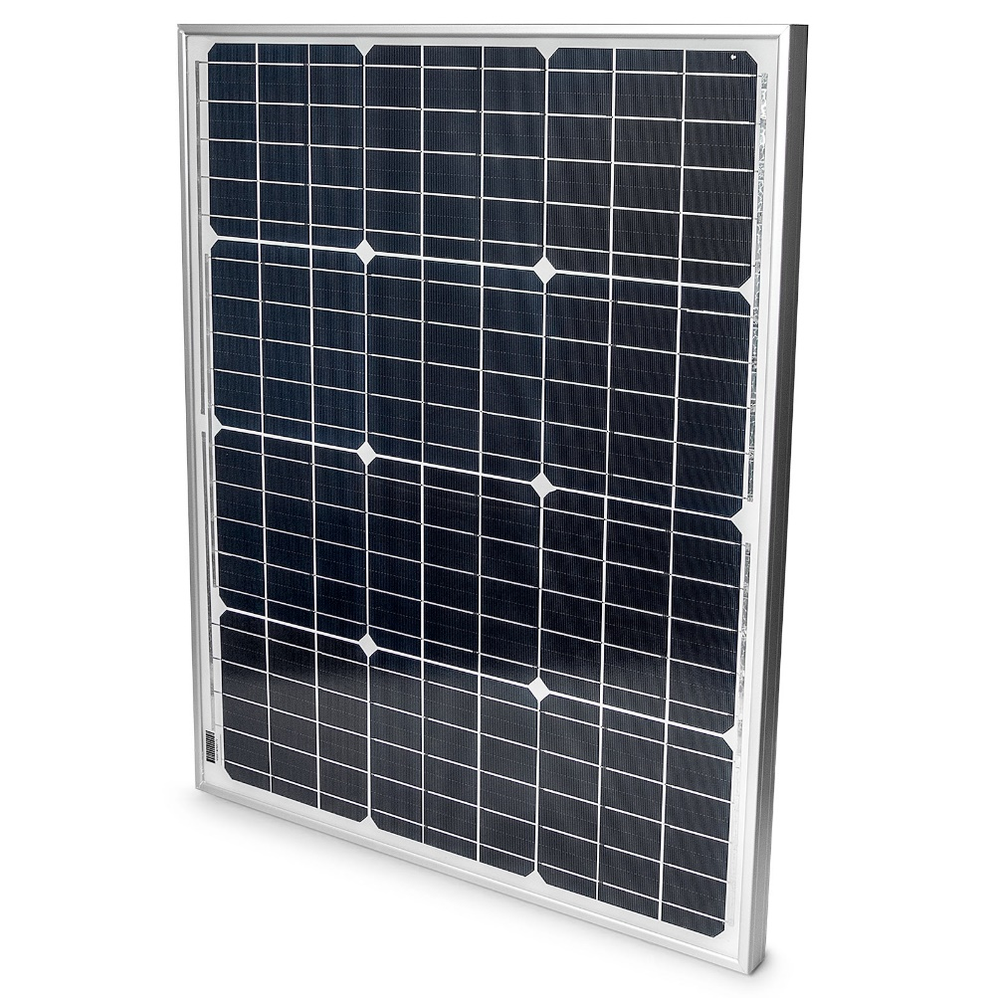
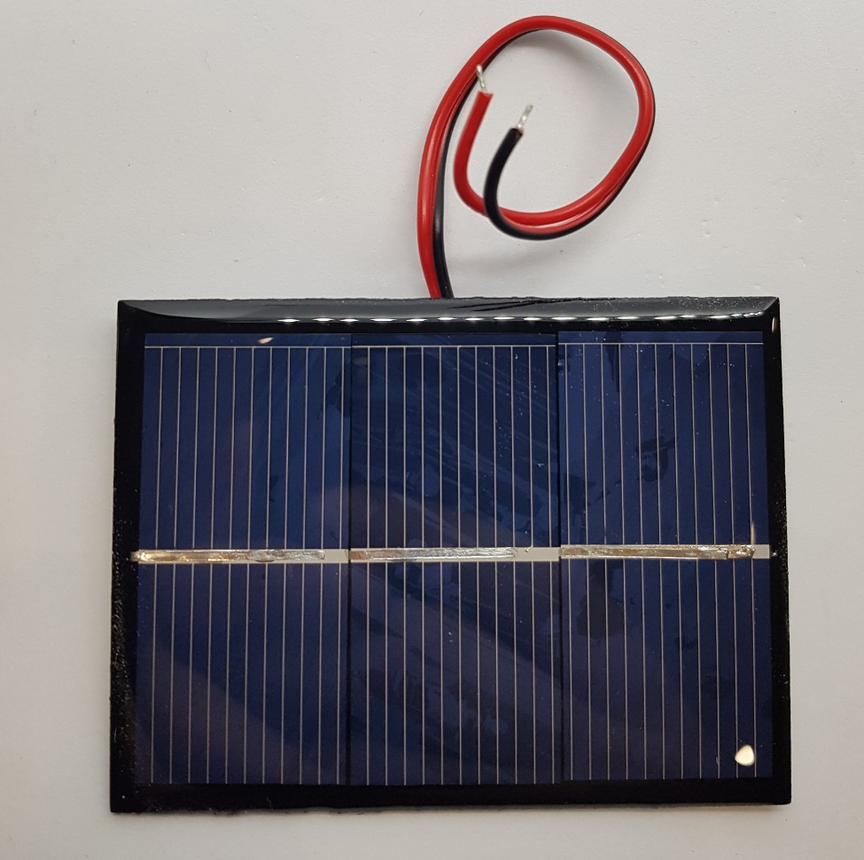
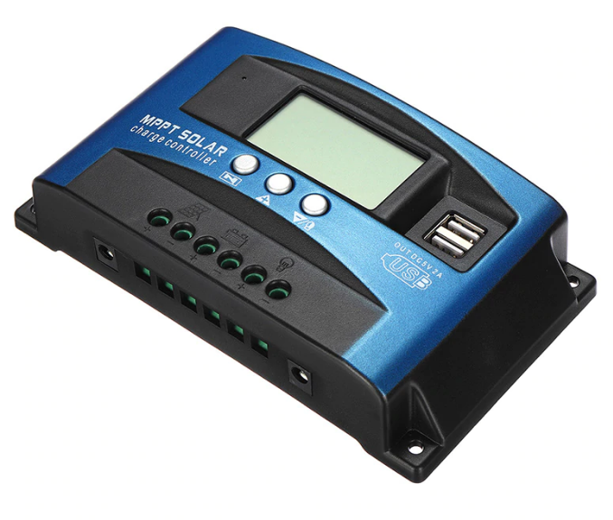
Sun-Tracking Solar Panel

Slide 4

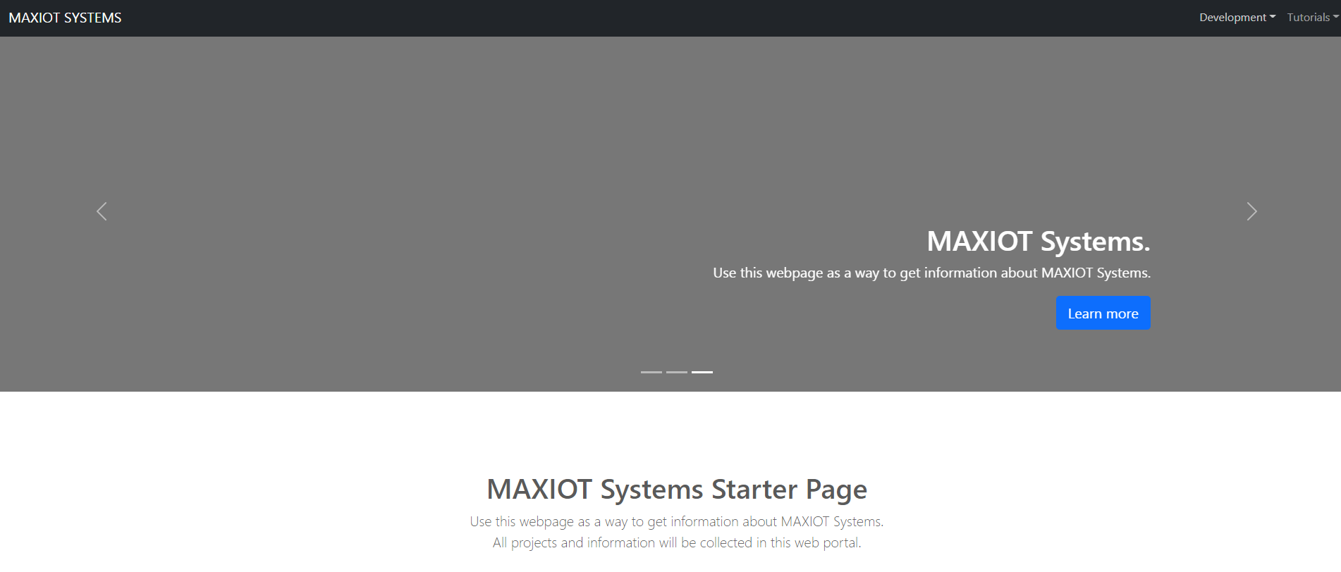
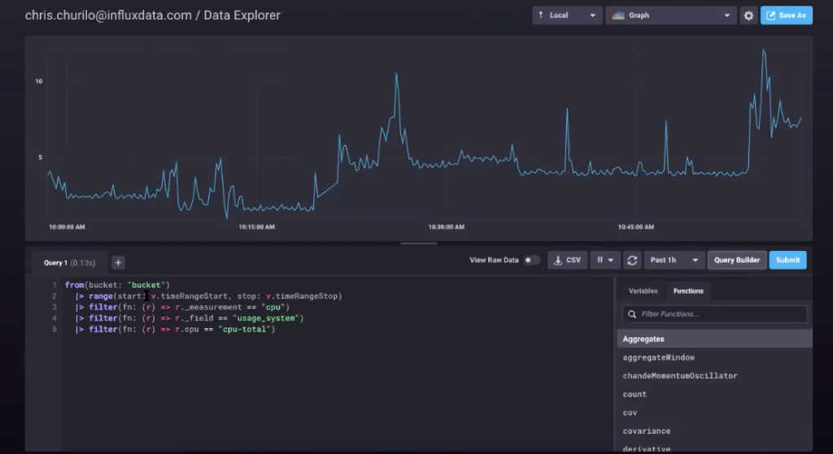
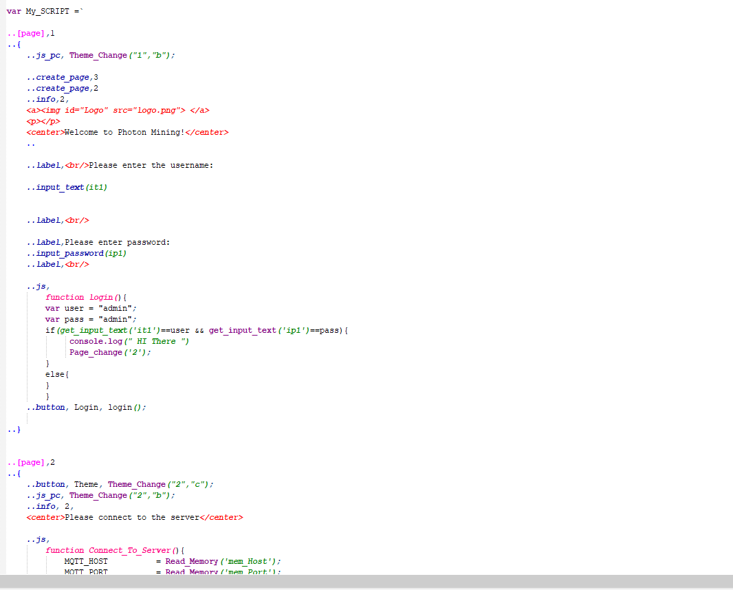
MAX-IOT

Slide 5
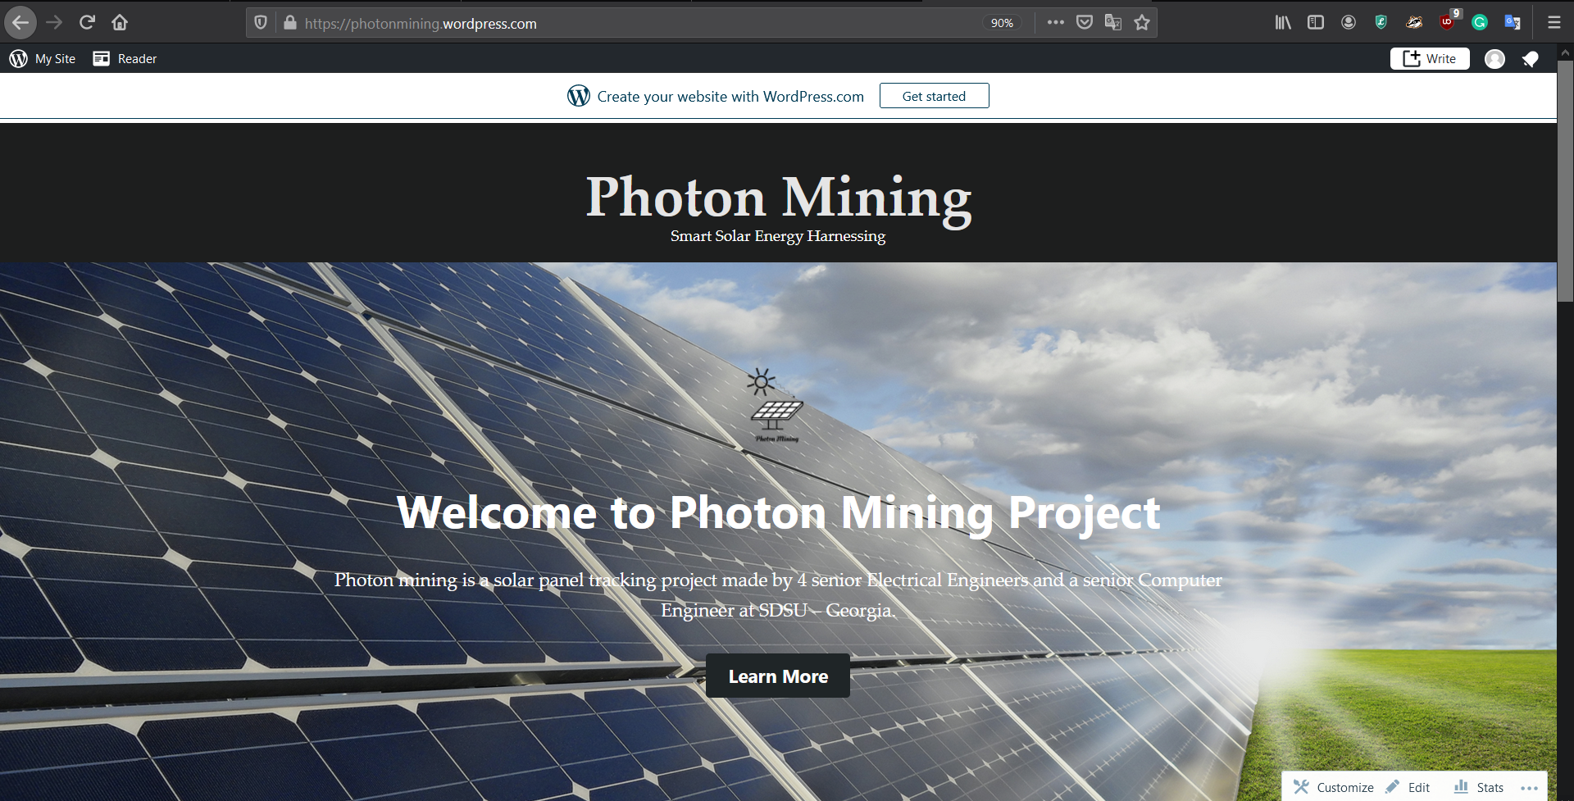
Webpage

Slide 6
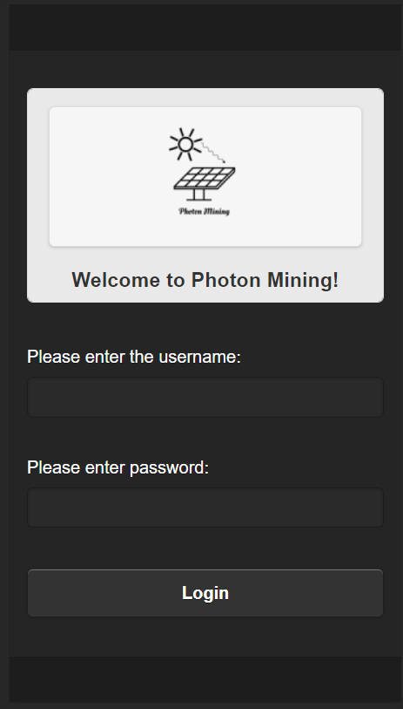
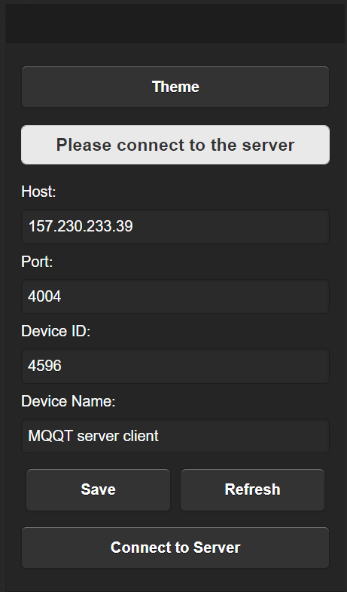
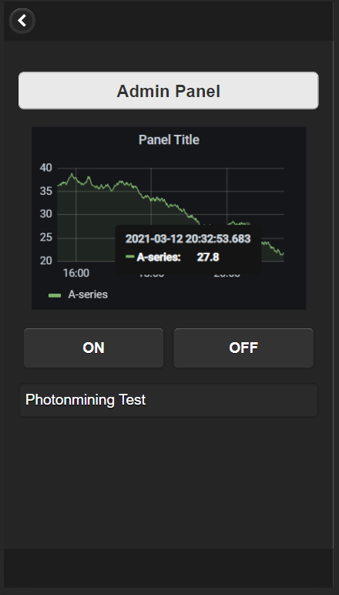
Web-APP (jQuery mobile) with smartphone GUI

Slide 7
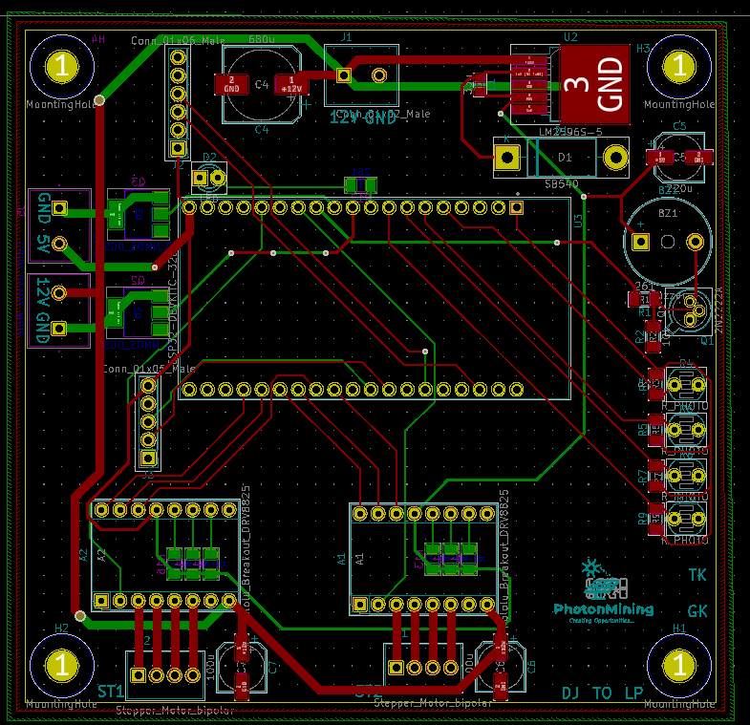
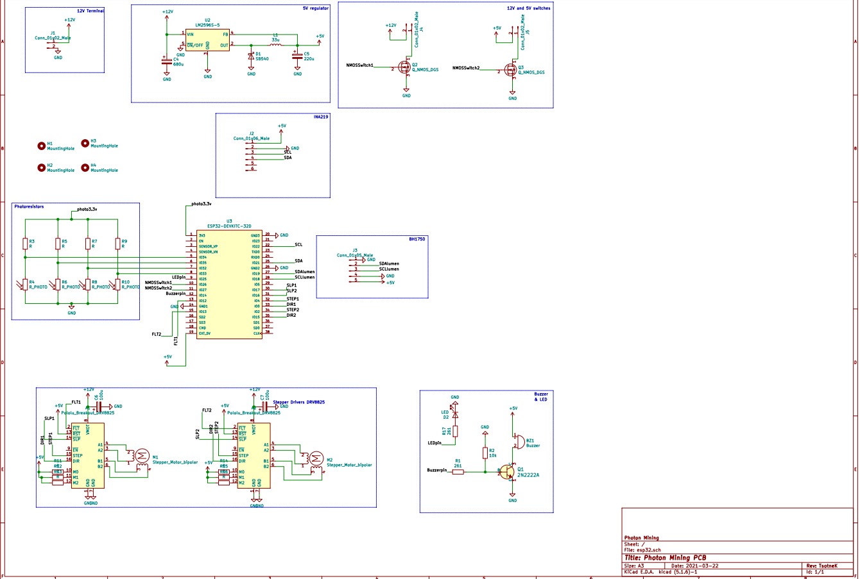
Schematic & PCB

Slide 8
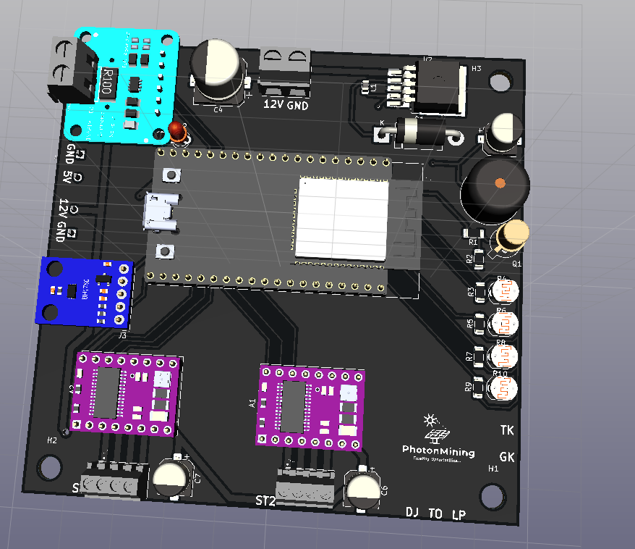
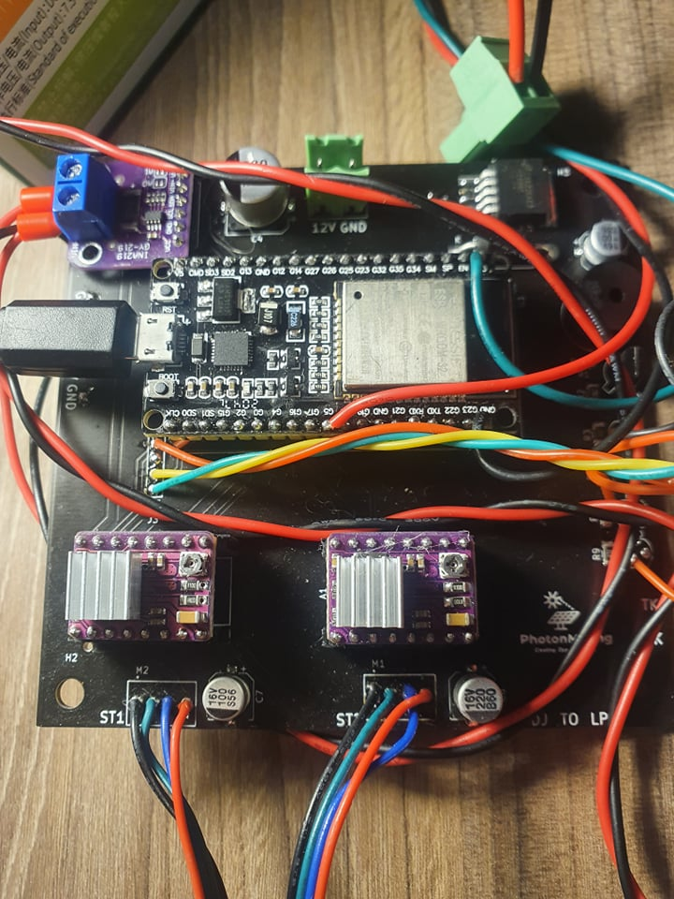
Printed Circuit Board (PCB) 3D Model

Slide 9

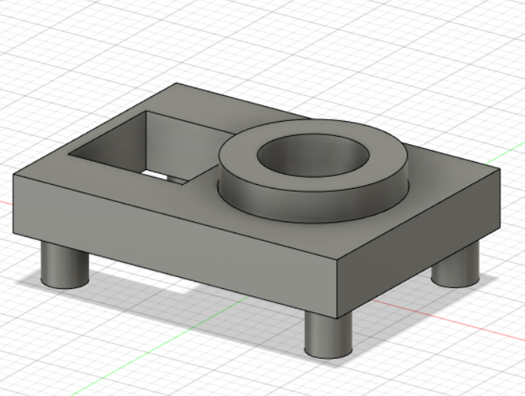
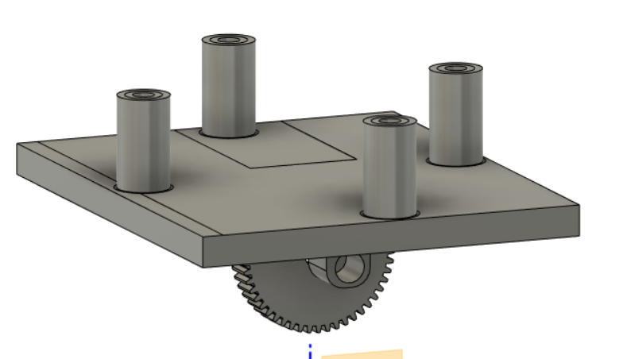
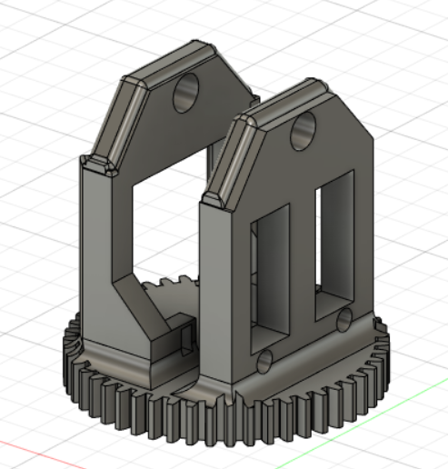
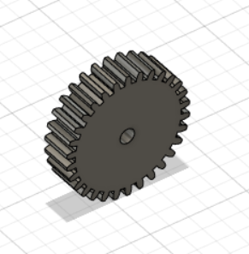

Mechanical Parts

Slide 10
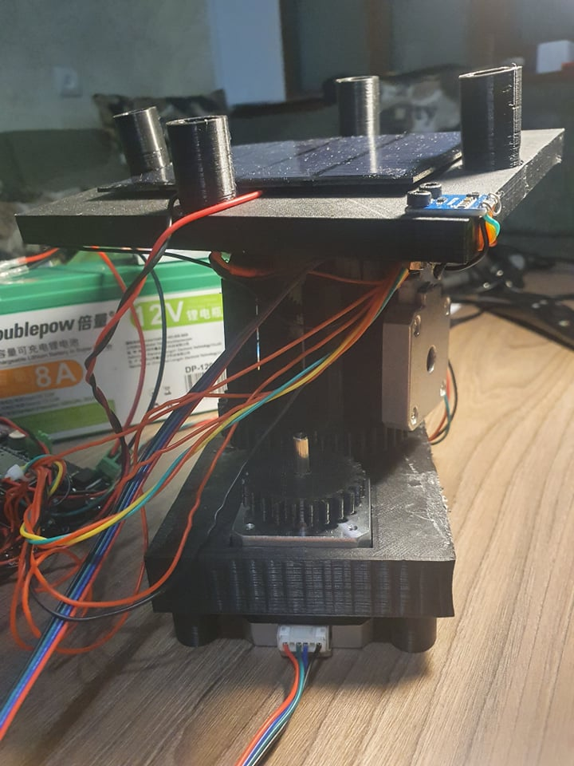
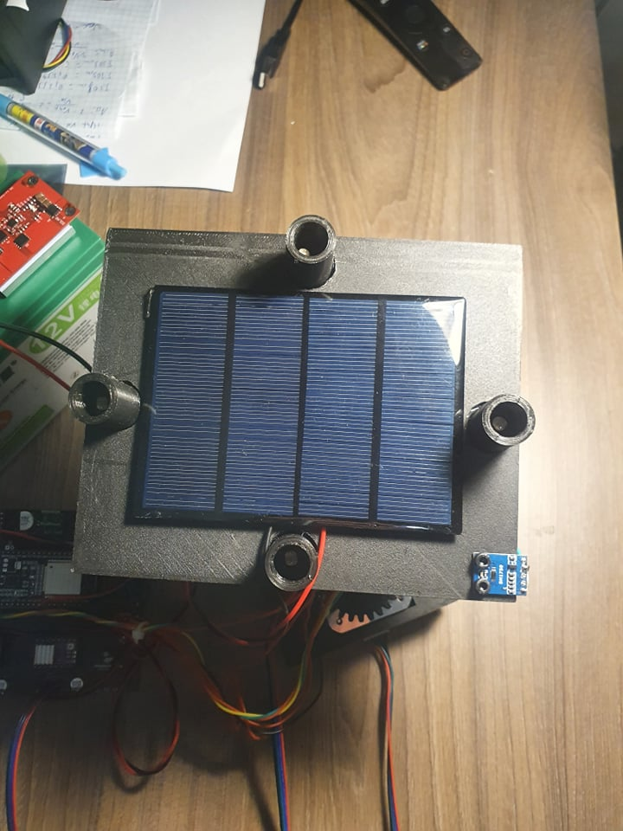
Mechanical Parts

Slide 11
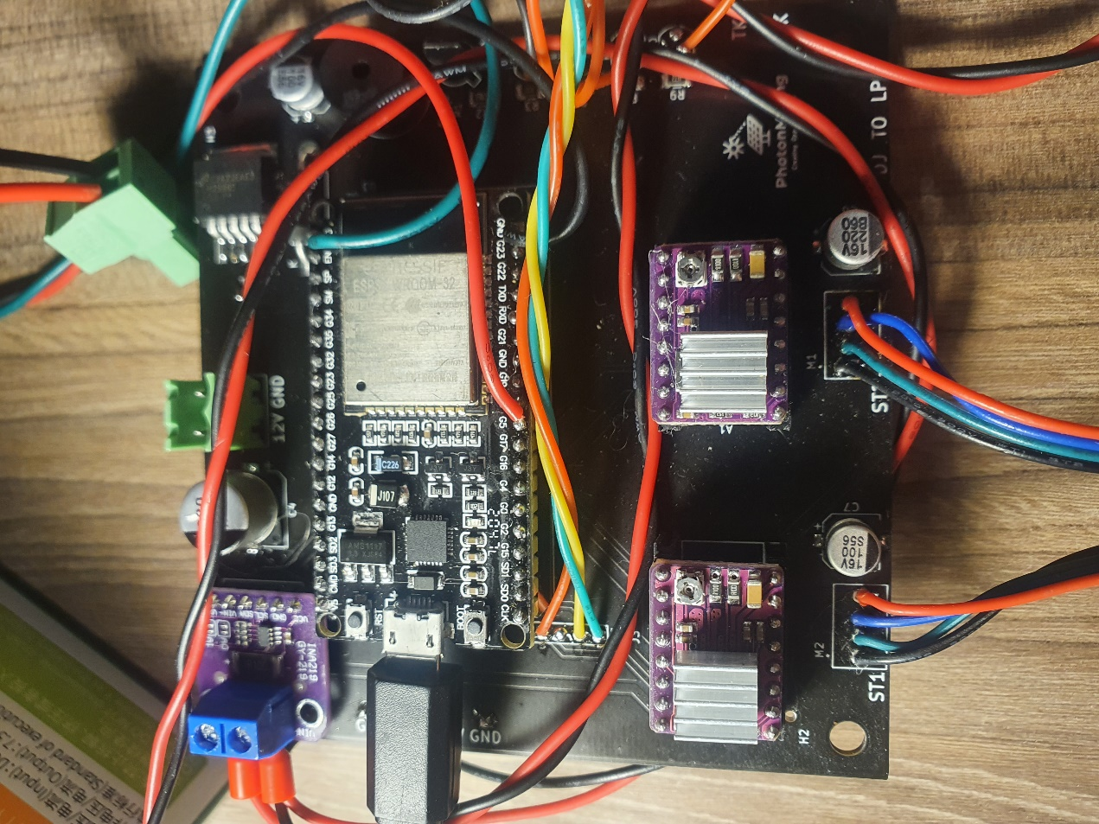
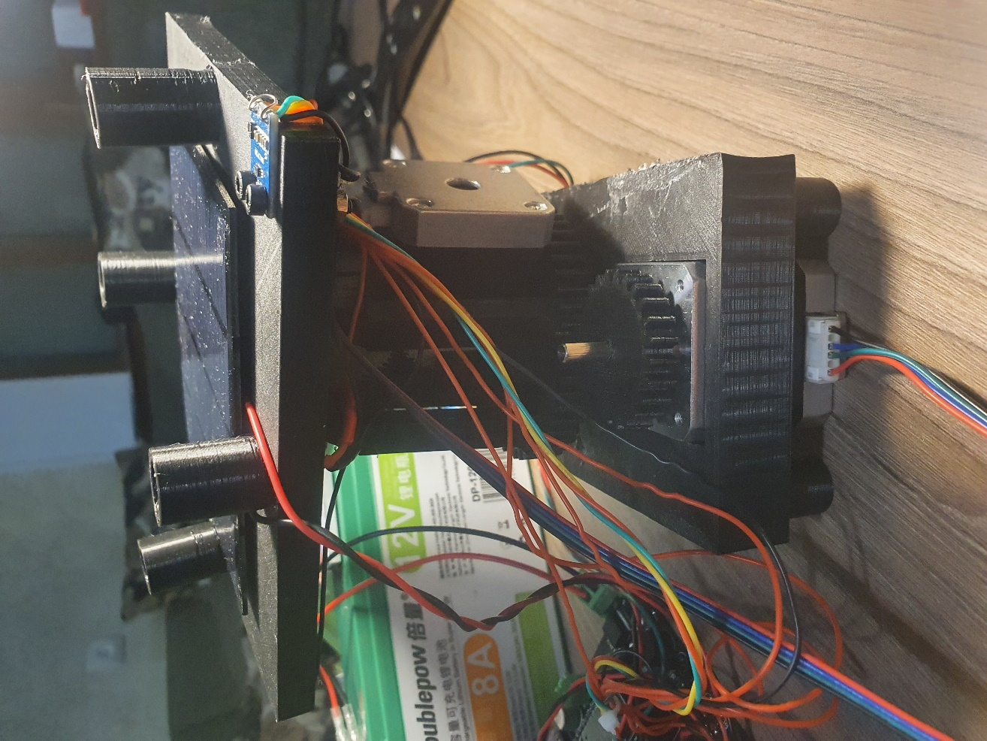
Final Product

Slide 12
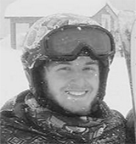
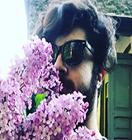
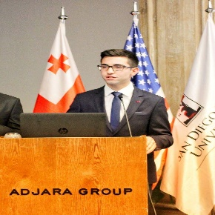
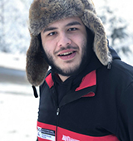
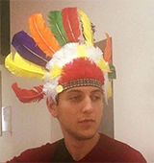
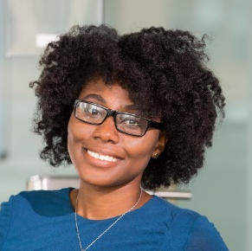
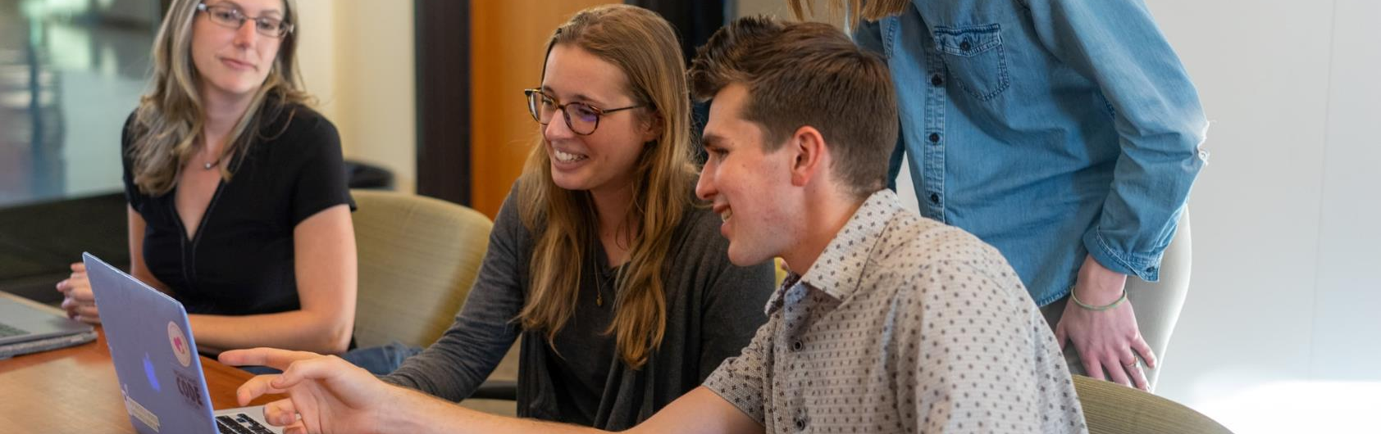





Meet Our Team
Tsotne Karchava
Dachi Janeldze
Guga Kupradze
Luka Pantsulatia
Timur Ozdemir
El.Engineer
El.Engineer
El.Engineer
Comp. Engineer
El.Engineer
Responsible for
Responsible for
Responsible for
Responsible for
Responsible for
Notes:
Photo by Julian Wan on Unsplash
Photo by Tyler Nix on Unsplash
Photo by Courtney Cook on Unsplash
Foto oleh George Ikwegbu dari Pexels
Photo by Christina @ wocintechchat.com on Unsplash
----
Photo by Clayton Cardinalli on Unsplash

Slide 13


Thanks!
Senior Design Project
SDSU-G
PhotonMining@gmail.com
Photonmining.wordpress.com
PhotonMining©
Creating Opportunities

